Slide 1
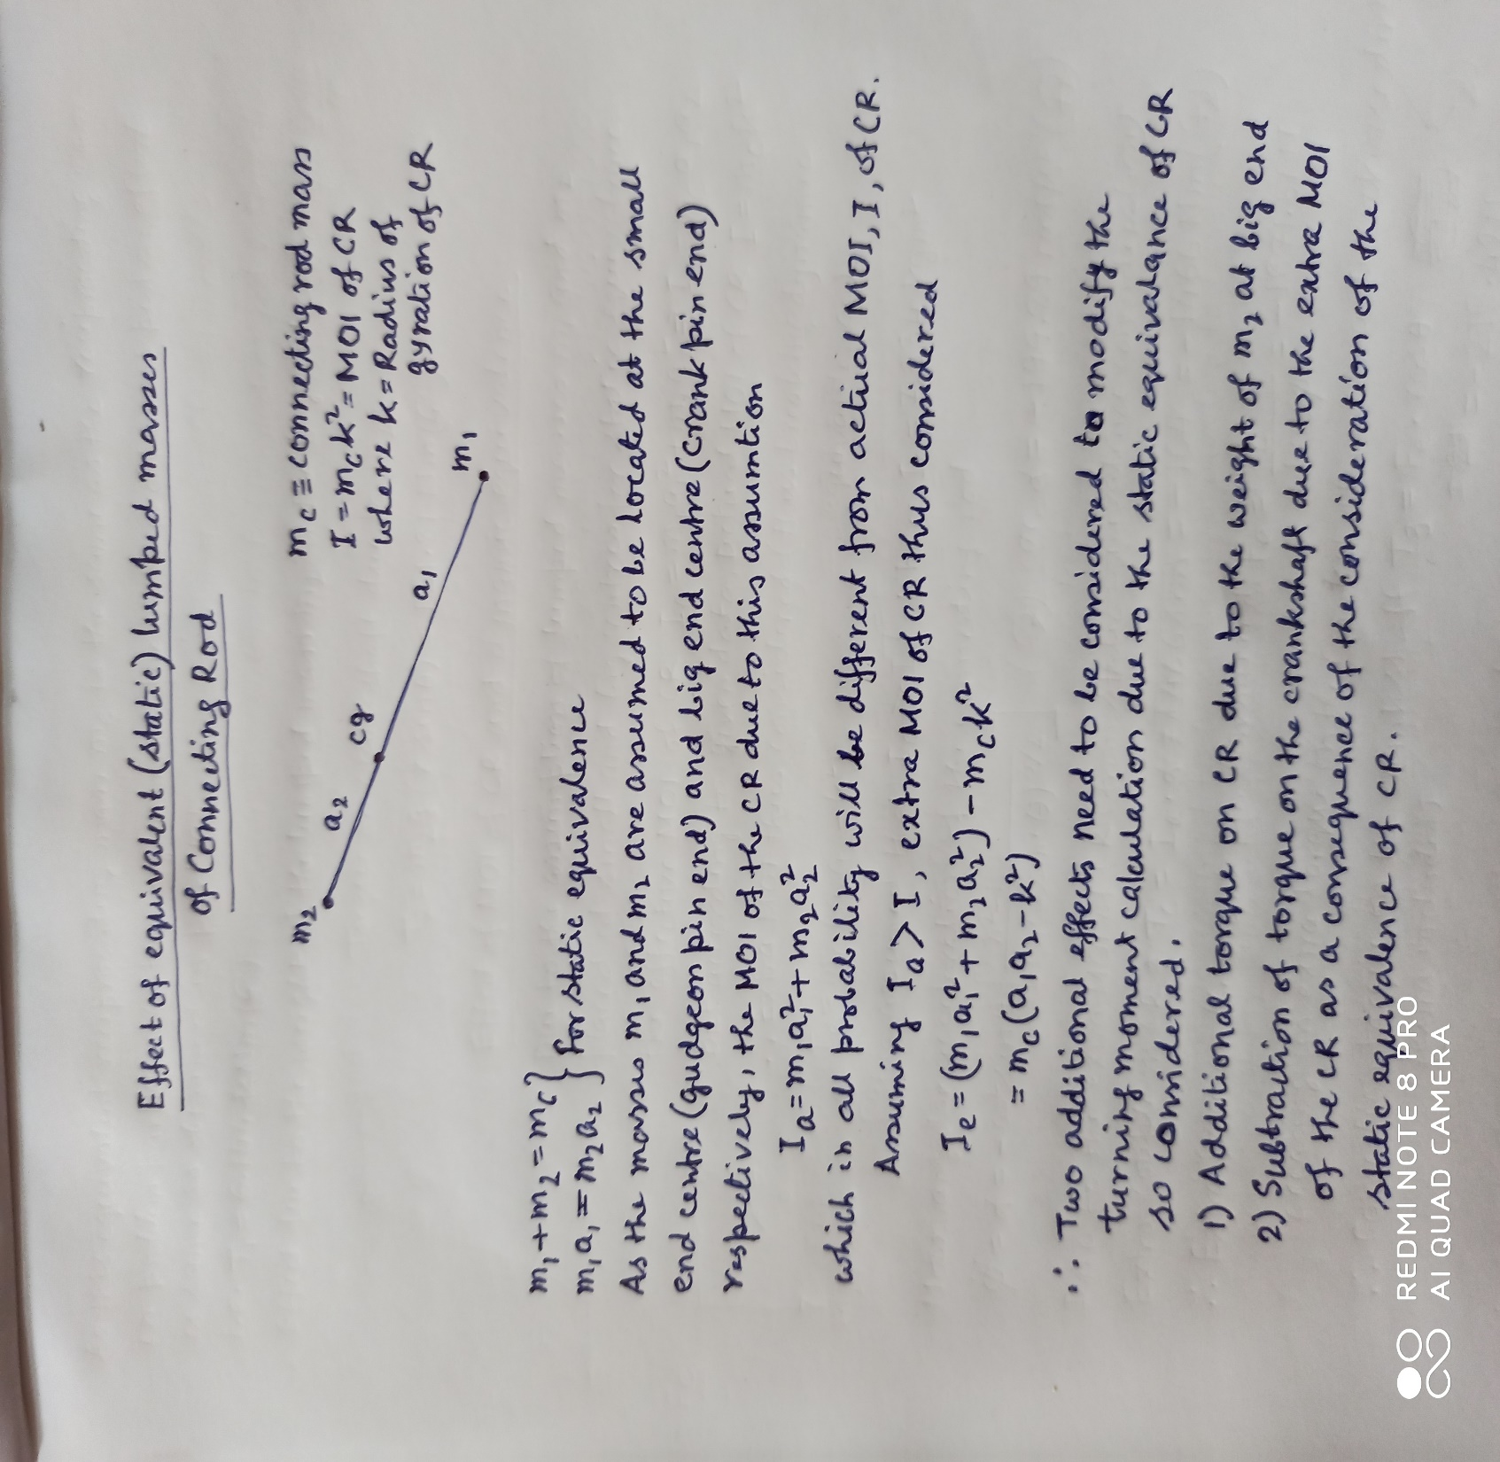
Effect of static equivalence due to lumped masses of the connecting rod on turning moment

Slide 2
PROBLEMS
A single cylinder vertical engine has a bore of 30 cm, a stroke of 40 cm and a connecting rod 80 cm long. The weight of the reciprocating parts is 1350 N. When the piston is at 10 cm and moving downwards during the expansion stroke gas pressure is 0.64 MPa. If the engine runs at 300 rpm, determine the turning moment on the crank shaft at that instant. In the above problem if the c.g. of the connecting rod is 50 cm from the small end, the radius of gyration about its centroidal axis is 30 cm, the weight of the reciprocating part is 900 N and that of the connecting rod is 1200 N, determine the corrected turning moment.
The data relating to a horizontal reciprocating engine are: mass of reciprocating part 120 kg, crank length 90 mm, engine speed 600 rpm, mass of connecting rod 90 kg, length between centres 450 mm, location of c.g. 180 mm from small end centre, radius of gyration about mass centre axis 150 mm. Find the magnitude and direction of the inertia torque on the crankshaft when the crank has turned through an angle of 30 degree from the IDC.

Slide 3
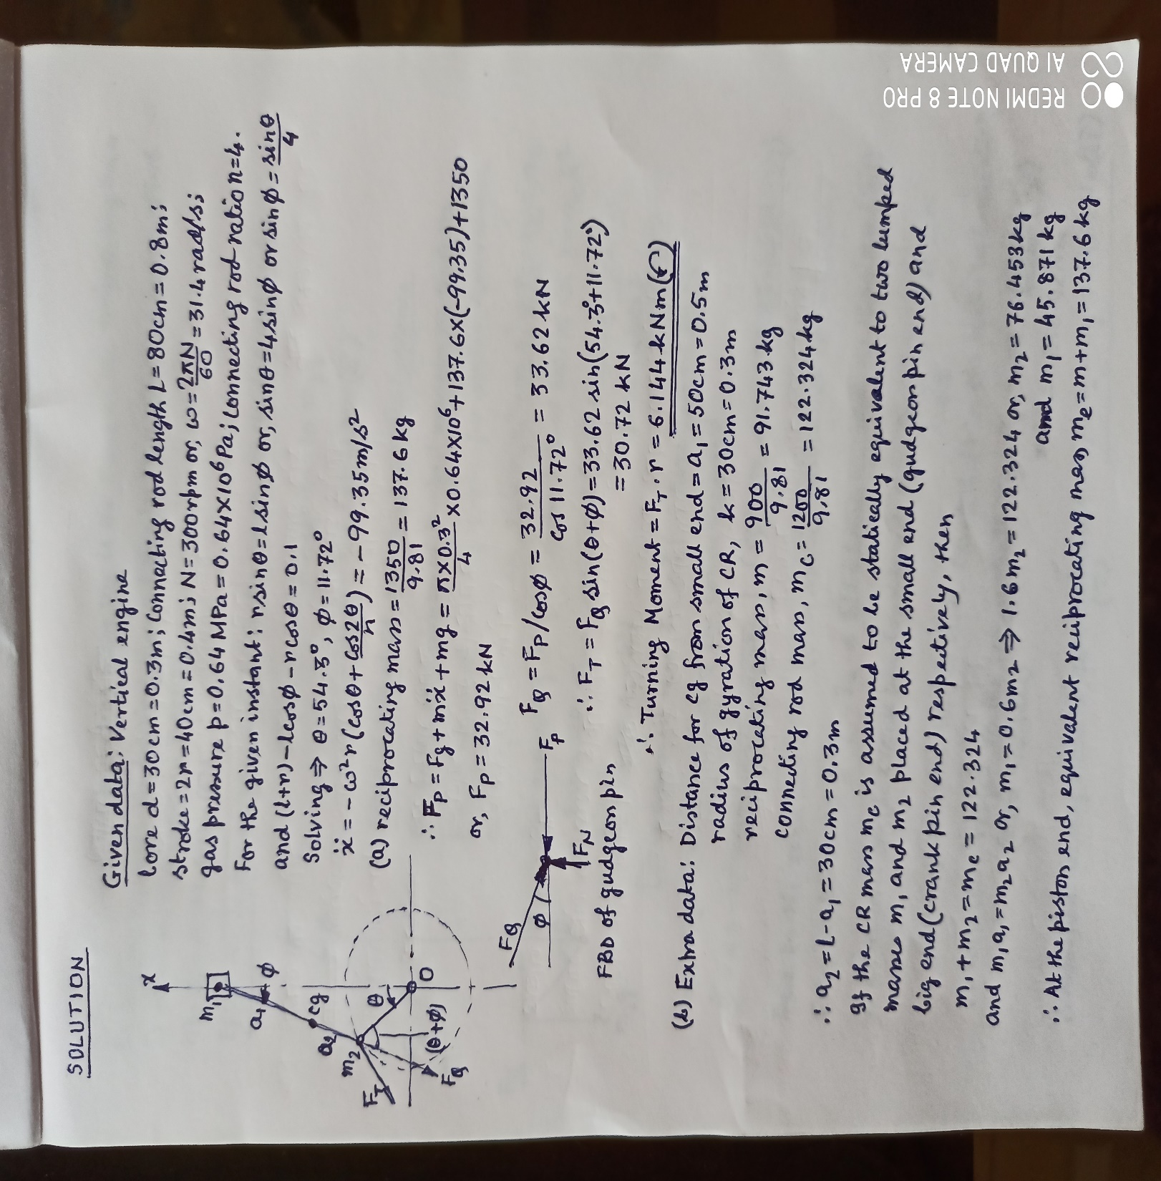
Solution of problem 1

Slide 4
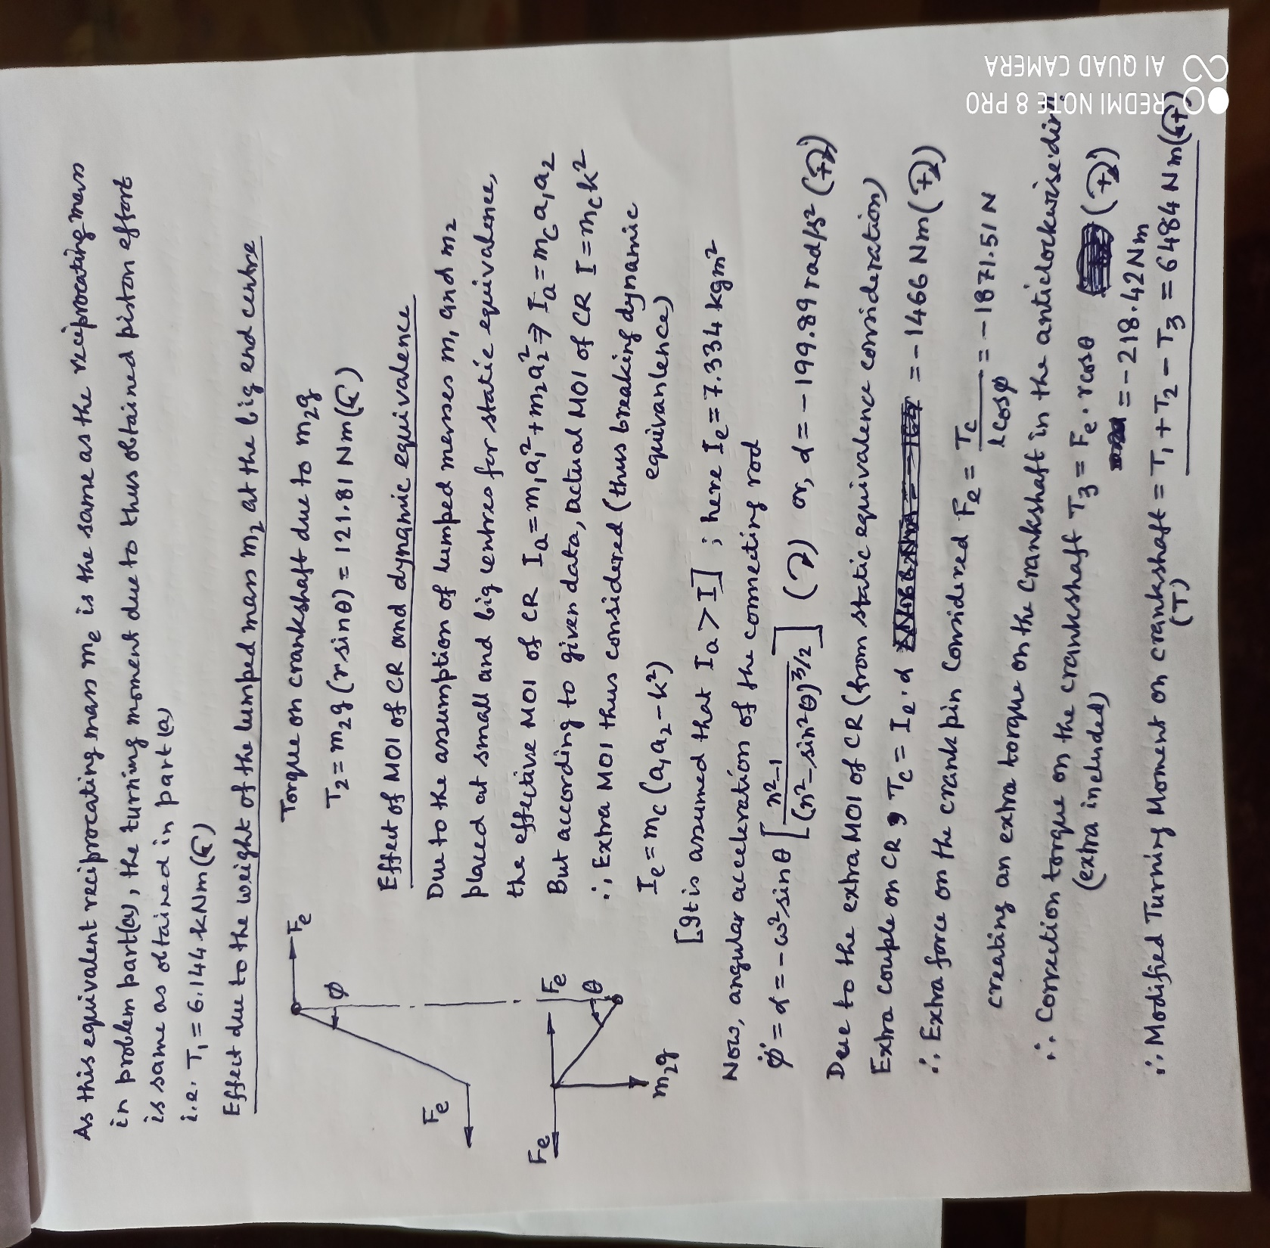
(continued)

Slide 5
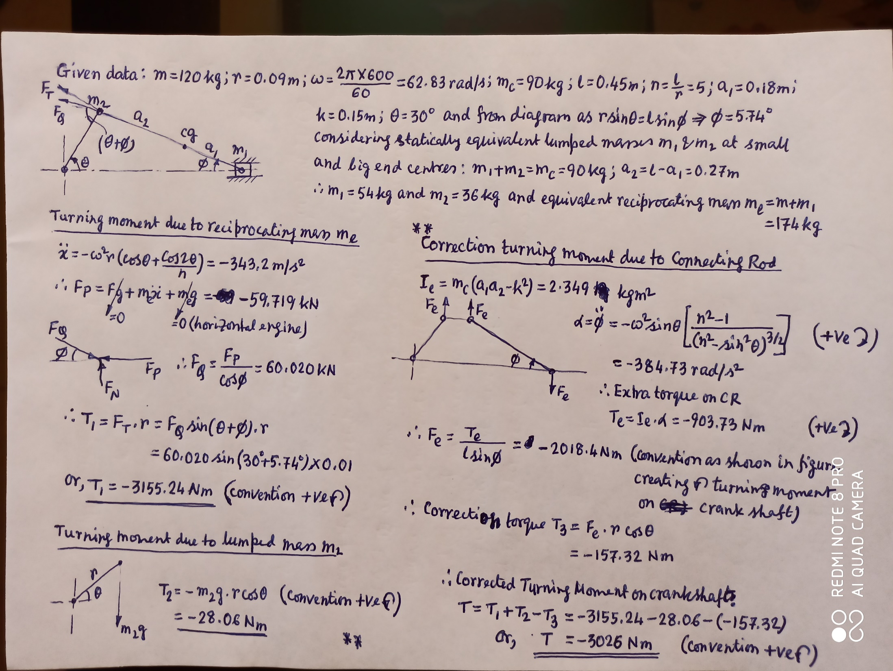
Solution of problem 2

Slide 6
Constituents of Turning moment on Crankshaft
Turning moment on crankshaft is obtained in the following path:
F_{P} -> F_{Q} -> F_{T} -> T
i.e. T = f(F_{P})
As F_{P} = F_{g} + mẍ + mg
Consequently, T = f(F_{g} + mẍ + mg)
= f(F_{g}) + f(mẍ) + f(mg)
= T_{g} + T_{i}̈ + T_{w}
Where, T_{g} is gas torque
T_{i}̈ is inertia torque
And T_{w} is torque due to the weight of the reciprocating parts.
*In general (and obviously for horizontal engine) T_{w} neglected.
*T is further refined (as discusses earlier) if the effect of connecting rod parameters are taken into consideration.

